Slide 1

Tokyo.R #80
2019.07.27
R Interface to Python
kilometer00

Slide 2

Who！？
誰だ？

Slide 3
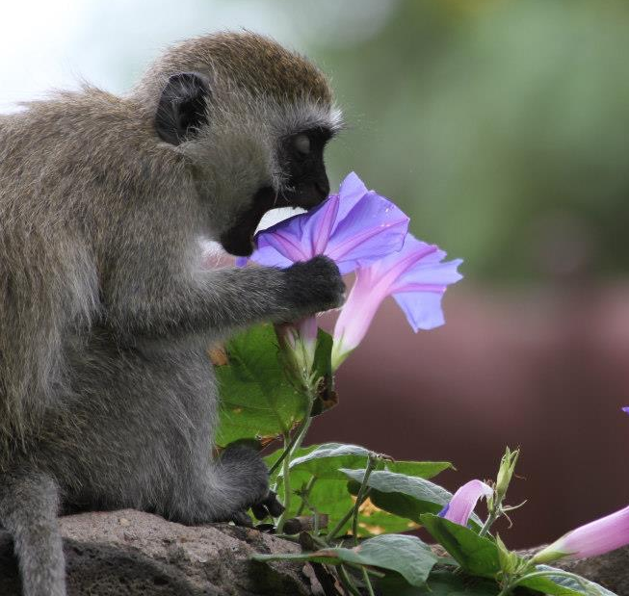
Who！？
名前： 三村 @kilometer
職業： ポスドク (こうがくはくし)
専門： 行動神経科学(霊長類)
脳イメージング
医療システム工学
R歴： ~ 10年ぐらい
流行: カメ

Slide 4
2018.07.15 Tokyo.R #71 Landscape with R – the Japanese R community
2018.10.20 Tokyo.R #73 BeginneR Session – Visualization & Plot
2019.01.19 Tokyo.R #75 BeginneR Session – Data pipeline
2019.03.02 Tokyo.R #76 BeginneR Session – Data pipeline
2019.04.13 Tokyo.R #77 BeginneR Session – Data analysis
2019.05.25 Tokyo.R #78 BeginneR Session – Data analysis
2019.06.29 Tokyo.R #79 BeginneR Session – 確率の基礎

Slide 5




BeginneR Session
BeginneR
BeginneR
Before
After

Slide 6



BeginneR
Advanced
Hoxo_m
If I have seen further it is by standing on the shoulders of Giants.
-- Sir Isaac Newton, 1676

Slide 7
R Interface to Python

Slide 8
一昔前
私もそろそろ
を、始めたいんだけど。
ぱそこん
できるんでしょ？教えてよ。
いいけど、
ぱそこん
で何がしたいの？
ぱそこん
って何でもできるんでしょ？
でも、どうしたらいいか分かんないんだ。

Slide 9
最近
私もそろそろ
を、始めたいんだけど。
じんこう
ちのー
できるんでしょ？教えてよ。
じんこう
ちのー
いいけど、
で何がしたいの？
じんこう
ちのー
って何でもできるんでしょ？
でも、どうしたらいいか分かんないんだ。

Slide 10

私もそろそろ
を、始めたいんだけど。
できるんでしょ？教えてよ。
いいけど、
で何がしたいの？
って何でもできるんでしょ？
でも、どうしたらいいか分かんないんだ。

Slide 11

私もそろそろ
を、始めたいんだけど。
できるんでしょ？教えてよ。
いいけど、
で何がしたいの？
って何でもできるんでしょ？
でも、どうしたらいいか分かんないんだ。

Slide 12

Do NOT start from here
Input
Output

Slide 13

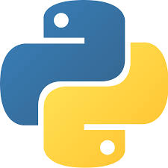
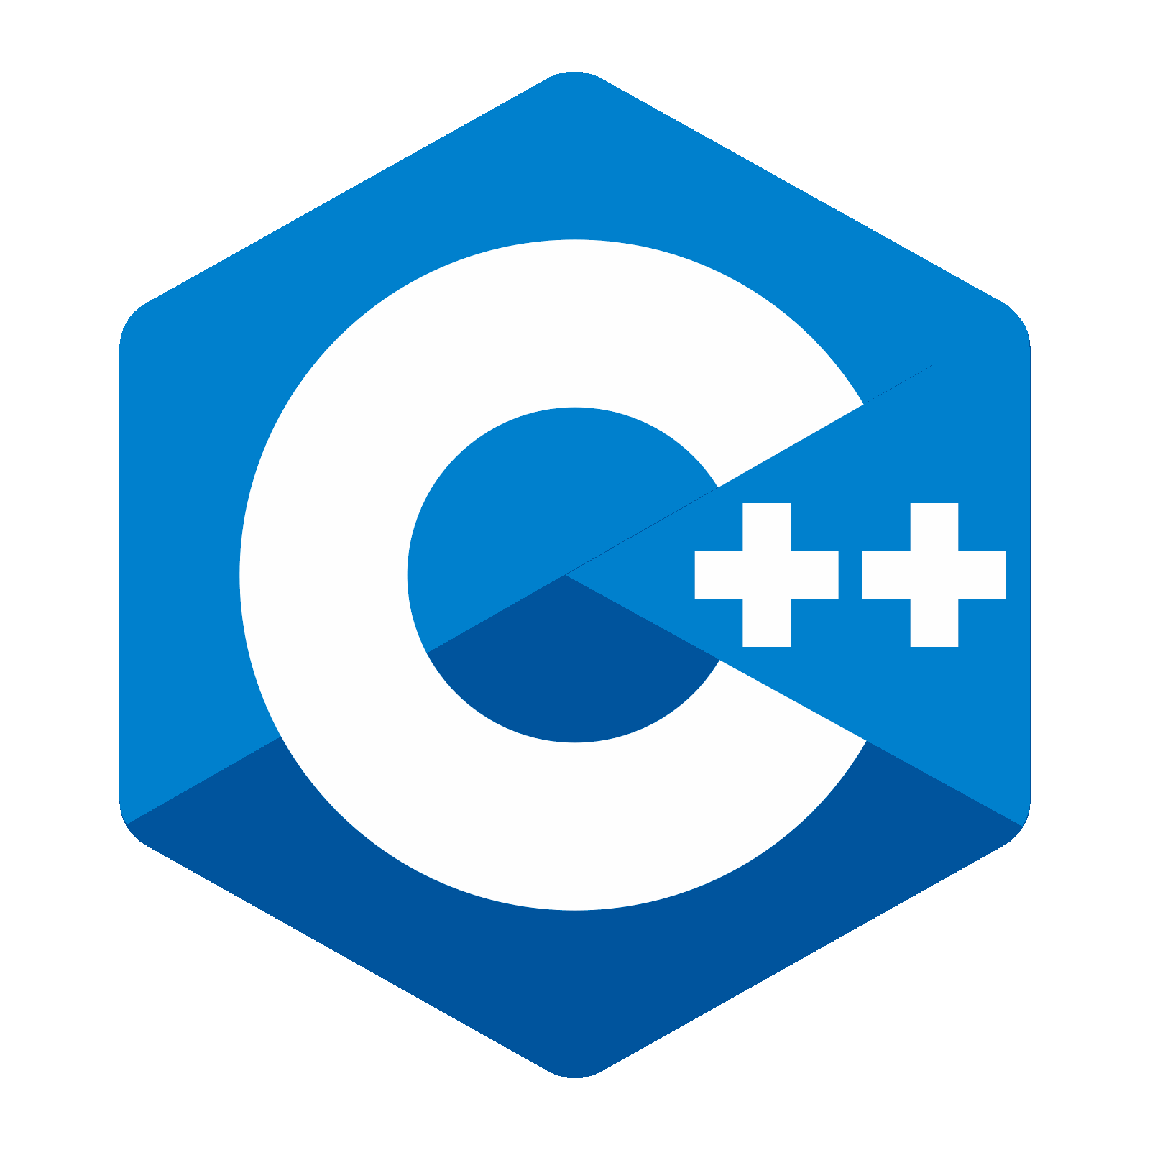
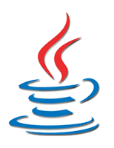
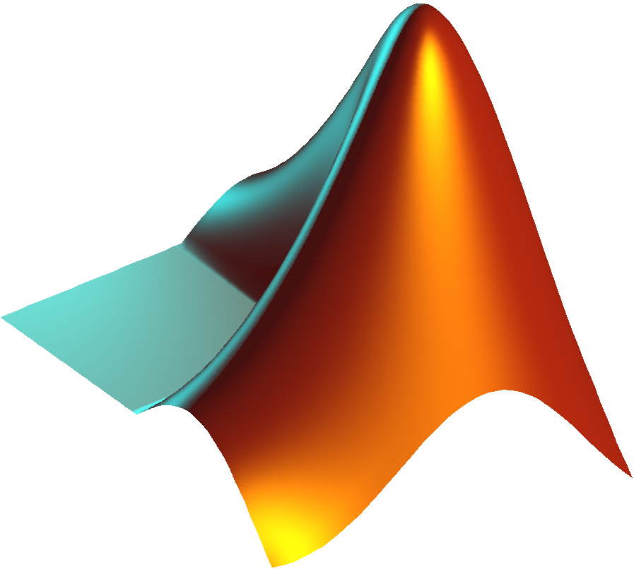
Do NOT start from here
Input
Whatever
Output
…

Slide 14
2
Do NOT start from here
Input
3
1
Whatever
Output
…

Slide 15

Input
Output

Slide 16
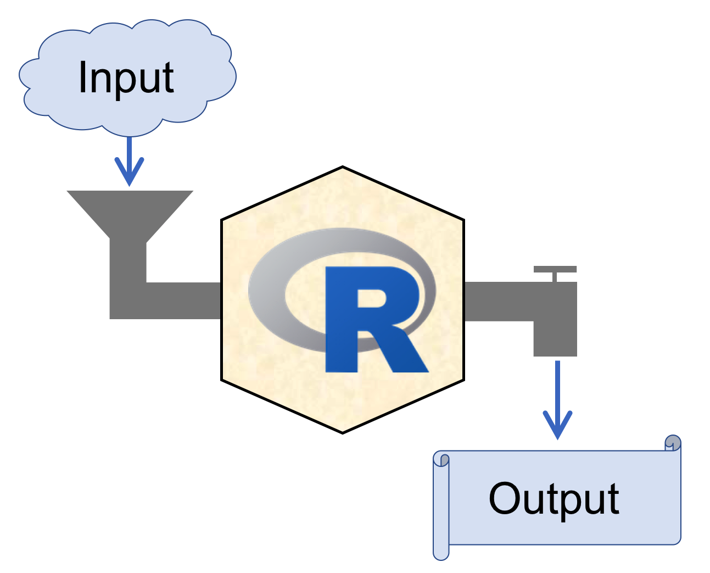

RStudio
https://www.rstudio.com/
Recommended!!
Integrated Development Environment

Slide 17
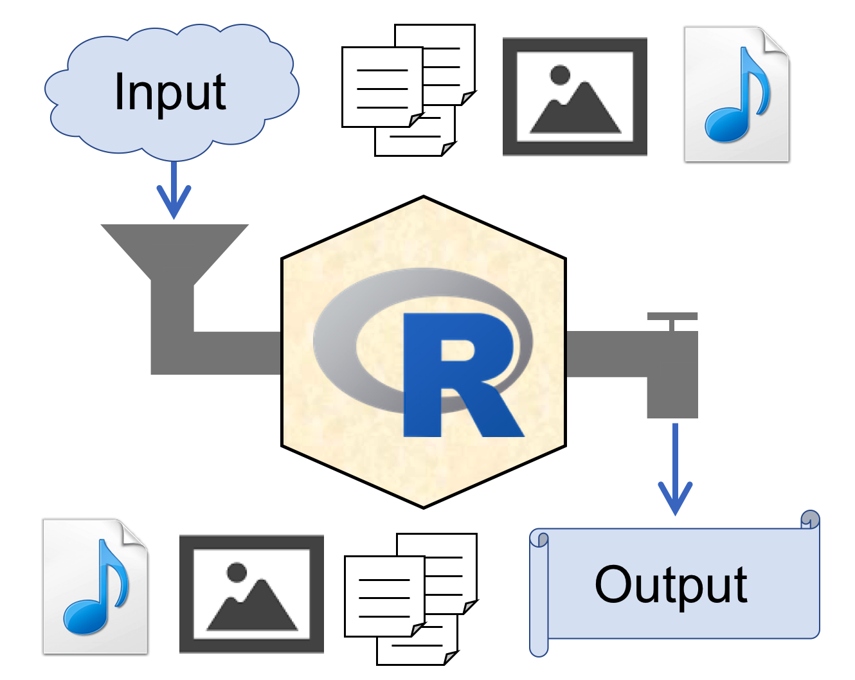
RStudio
https://www.rstudio.com/
Integrated Development Environment

Slide 18
RStudio

Slide 19
RStudio
Projects

Slide 20
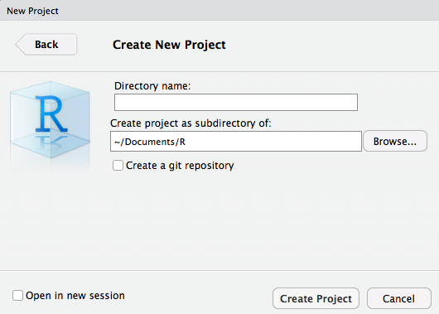
File > New Project… > New Directory > New Project
hogehoge

Slide 21



~/Documents/R
Project Root Directory
New!!
hogehoge
Double click!!
hogehoge.Rproj
Open project
.Rproj.user
Auto saved
project information
.RData
.Rhistory

Slide 22
~/Documents/R
project3
project1
project4
project2

Slide 23
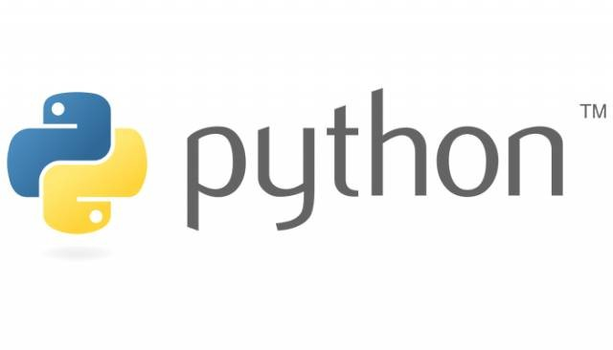

Slide 24
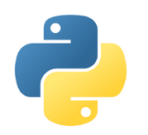
Variable assignment & naming
○
var_1 <- 1
○
1 -> var_1
○
var_1 = 1
var_1 = 1
▼
×
1var <- 1
×
1var = 1
×
_var <- 1
_var = 1
▼
○
.var <- 1
×
.var = 1
var.1 <- 1
var.1 = 1
○
▼
list <- 1
list = 1
▼
▼

Slide 25
Variable type (basic)
Character
String
> typeof("1")
[1] "character"
>>> type("1")
<type 'str'>
Double
Float
> typeof(1)
[1] "double"
> typeof(1.0)
[1] "double"
>>> type(1.0)
<type 'float'>
Integer
Integer
> typeof(as.integer(1))
[1] "integer"
>>> type(1) <type 'int'>
> typeof(1L)
[1] "integer"

Slide 26
Use packages
library(reticulate)
py_str(...)
imort numpy
numpy.array([1:3])
or
or
imort numpy as np
np.array([1:3])
reticulate::py_str(...)
or
from numpy import array
array([1:3])

Slide 27
Loop
for(i in 1:10){
i = i + 1
}
for i in range(10):
i = i + 1
for(i in 1:10){
i = i + 1
}
× INDENT ERROR
for i in range(10):
i = i + 1
for i in range(10):
i += i
for(i in 1:10) i = i + 1

Slide 28
Function definition
f <- function(val1, ...){
....
return(...)
}
def f(val1, ...):
....
return(...)
CHECK YOUR INDENT
Import & Export csv
import pandas as pd
dat = pd.read_csv(<path>)
dat.to_csv(<path>)
dat <- read.csv(<path>)
write.csv(dat, <path>)

Slide 29


Slide 30


$$≈$$

Slide 31

reticulate package
URL: https://github.com/rstudio/reticulate

Slide 32
reticulate package
Calling Python from R in a variety of ways including R Markdown, sourcing Python scripts, importing Python modules, and using Python interactively within an R session.
Translation between R and Python objects (for example, between R and Pandas data frames, or between R matrices and NumPy arrays).
URL: https://github.com/rstudio/reticulate

Slide 33
Environment setup
for Python
(in macOS Mojave 10.14.3)

Slide 34

Sandbox

Slide 35
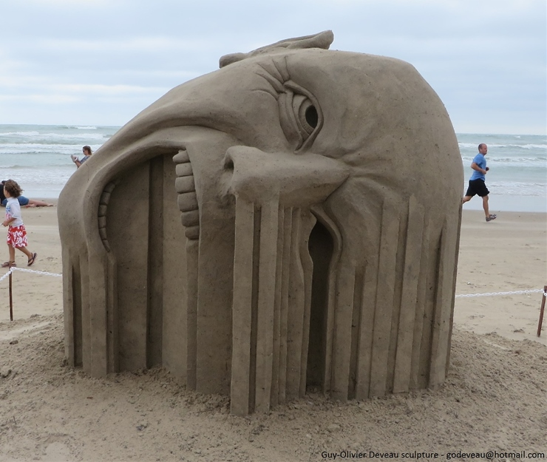

http://buzz-plus.com/2014/07/25/suna/
Sandbox
http://www.sandart-j.com/work/work3.html

Slide 36
Sandbox A
http://buzz-plus.com/2014/07/25/suna/
Sandbox B
http://www.sandart-j.com/work/work3.html

Slide 37
Sandbox A
Isolated
&
Independent
http://buzz-plus.com/2014/07/25/suna/
Sandbox B
http://www.sandart-j.com/work/work3.html

Slide 38
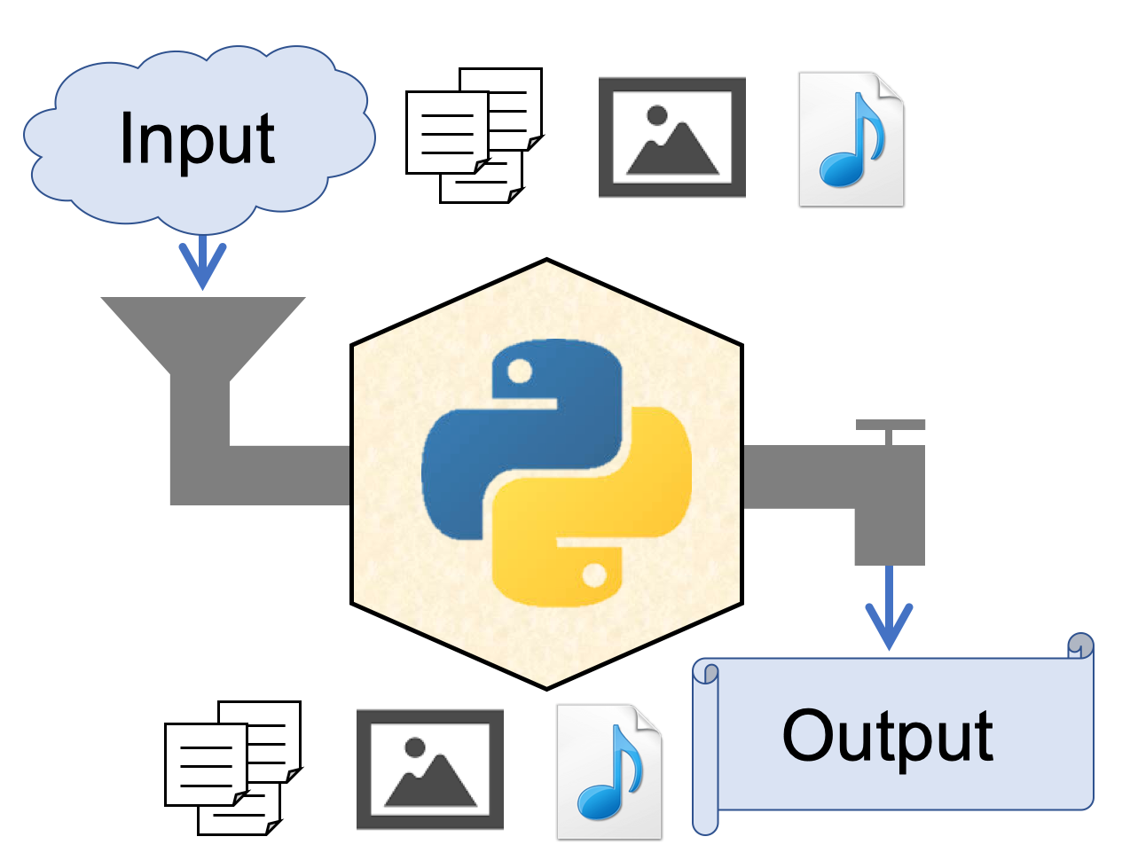
"Sandboxed" Python
Isolated & Independent virtual environment for secure and reproducibility
A sandbox is a type of software testing environment that enables the isolated execution of software or programs for independent evaluation, monitoring or testing.

Slide 39
RStudio
Projects

Slide 40
"Sandboxed" Python
Isolated & Independent virtual environment for security & reproducibility
[python]
version = "3.7"
[packages]
cycler==0.10.0
kiwisolver==1.1.0
matplotlib==3.1.1
numpy==1.16.4
opencv-python==4.1.0.25
pandas==0.25.0
pyparsing==2.4.0
PypeR==1.1.2 ...
[python]
version = "2.7"
[packages]
numpy==1.16.4
...

Slide 41
Pipenv
→ "Sandboxed" Python manager
Install Python
Recommended!!
https://www.python.org/
Install Pipenv (in MacOS)
$ brew install pipenv

Slide 42
Pipenv
→ "Sandboxed" Python manager
Create virtualenv
$ cd <project root>
$ pipenv --python 3.7
<project root>
.venv
← interpreter, env info
Pipfile
← package info

Slide 43
Pipenv
→ "Sandboxed" Python manager
Activate virtualenv
$ pipenv shell
Deactivate virtualenv
(prj) $ exit
Delete virtualenv
$ pipenv --rm

Slide 44
Pipenv
→ "Sandboxed" Python manager
Activate virtualenv
$ pipenv shell
Install packages
(prj) $ pipenv install <pkg>~=<version>
Uninstall packages
(prj) $ pipenv uninstall <pkg>

Slide 45
For {reticulate},
you need NumPy package
in your virtualenv.

Slide 46
Pipenv
→ "Sandboxed" Python manager
Install Numpy
$ cd <prj>
$ pipenv shell
(prj) $ pipenv install numpy
# activate
# install
(prj) $ pipenv run pip freeze
# check
(prj) $ python
>>> import numpy
# check

Slide 47
Pipenv
→ "Sandboxed" Python manager
Address of the virtualenv
$ cd <prj>
$ pipenv shell
(prj) $ pipenv --venv
<prj>/.venv
# activate
# check

Slide 48
back to

Slide 49
Use Python in R
Install reticulate from CRAN
install.packages(reticulate)
Attach Python virtualenv
library(reticulate)
pyenv <- "<prj>/.venv/bin/python"
use_python(python = pyenv, required = TRUE)

Slide 50
Use Python in R
Check your Python
py_config()
## python: <prj>/.venv/bin/python
## libpython: /Library/Frameworks/Python.framework...
## pythonhome: /Library/Frameworks/Python.fram...
## virtualenv: <prj>/.venv/bin/activate_this.py
## version: 3.7.4 (v3.7.4:e09359112e, Jul 8 2019...
## numpy: <prj>/.venv/lib/python3.7/site-packages/...
## numpy_version: 1.16.4
##
## NOTE: Python version was forced by use_python...

Slide 51
Use Python in R
Import Python pkg in R
os <- import("os")
Use Python pkg in R
os$listdir()
## [1] ".Rhistory" ".DS_Store"
## [2] ".gitignore" ".RData"
## ...

Slide 52
Use Python in R
Import Python source file
source_python("sample.py")
sample.py
import pandas as pd
def pd_load_csv(path):
df = pd.read_csv(path)
return df
def pd_head(df, n = 3):
return df.head(n)
File > New File > Python script

Slide 53
Use Python in R
Import Python source
source_python("sample.py")
dat <- pd_load_csv("hoge.csv")
pd_head(dat)
iris %>% pd_head

Slide 54
Benchmark test
source_python("sample.py")
f_pd <- function(path) pd_load_csv(path)
f_base <- function(path) read.csv(path)
f_readr <- function(path) readr::read_csv(path)
f_fread <- function(path) data.table::fread(path)

Slide 55
Benchmark test
source_python("sample.py")
f_pd <- function(path) pd_load_csv(path)
f_base <- function(path) read.csv(path)
f_readr <- function(path) readr::read_csv(path)
f_fread <- function(path) data.table::fread(path)
microbenchmark::microbenchmark(
pd_load_csv = f_pd(path),
read.csv = f_base(path),
read_csv = f_readr(path),
fread = f_fread(path)) -> mbm
ggplot2::autoplot(mbm)

Slide 56
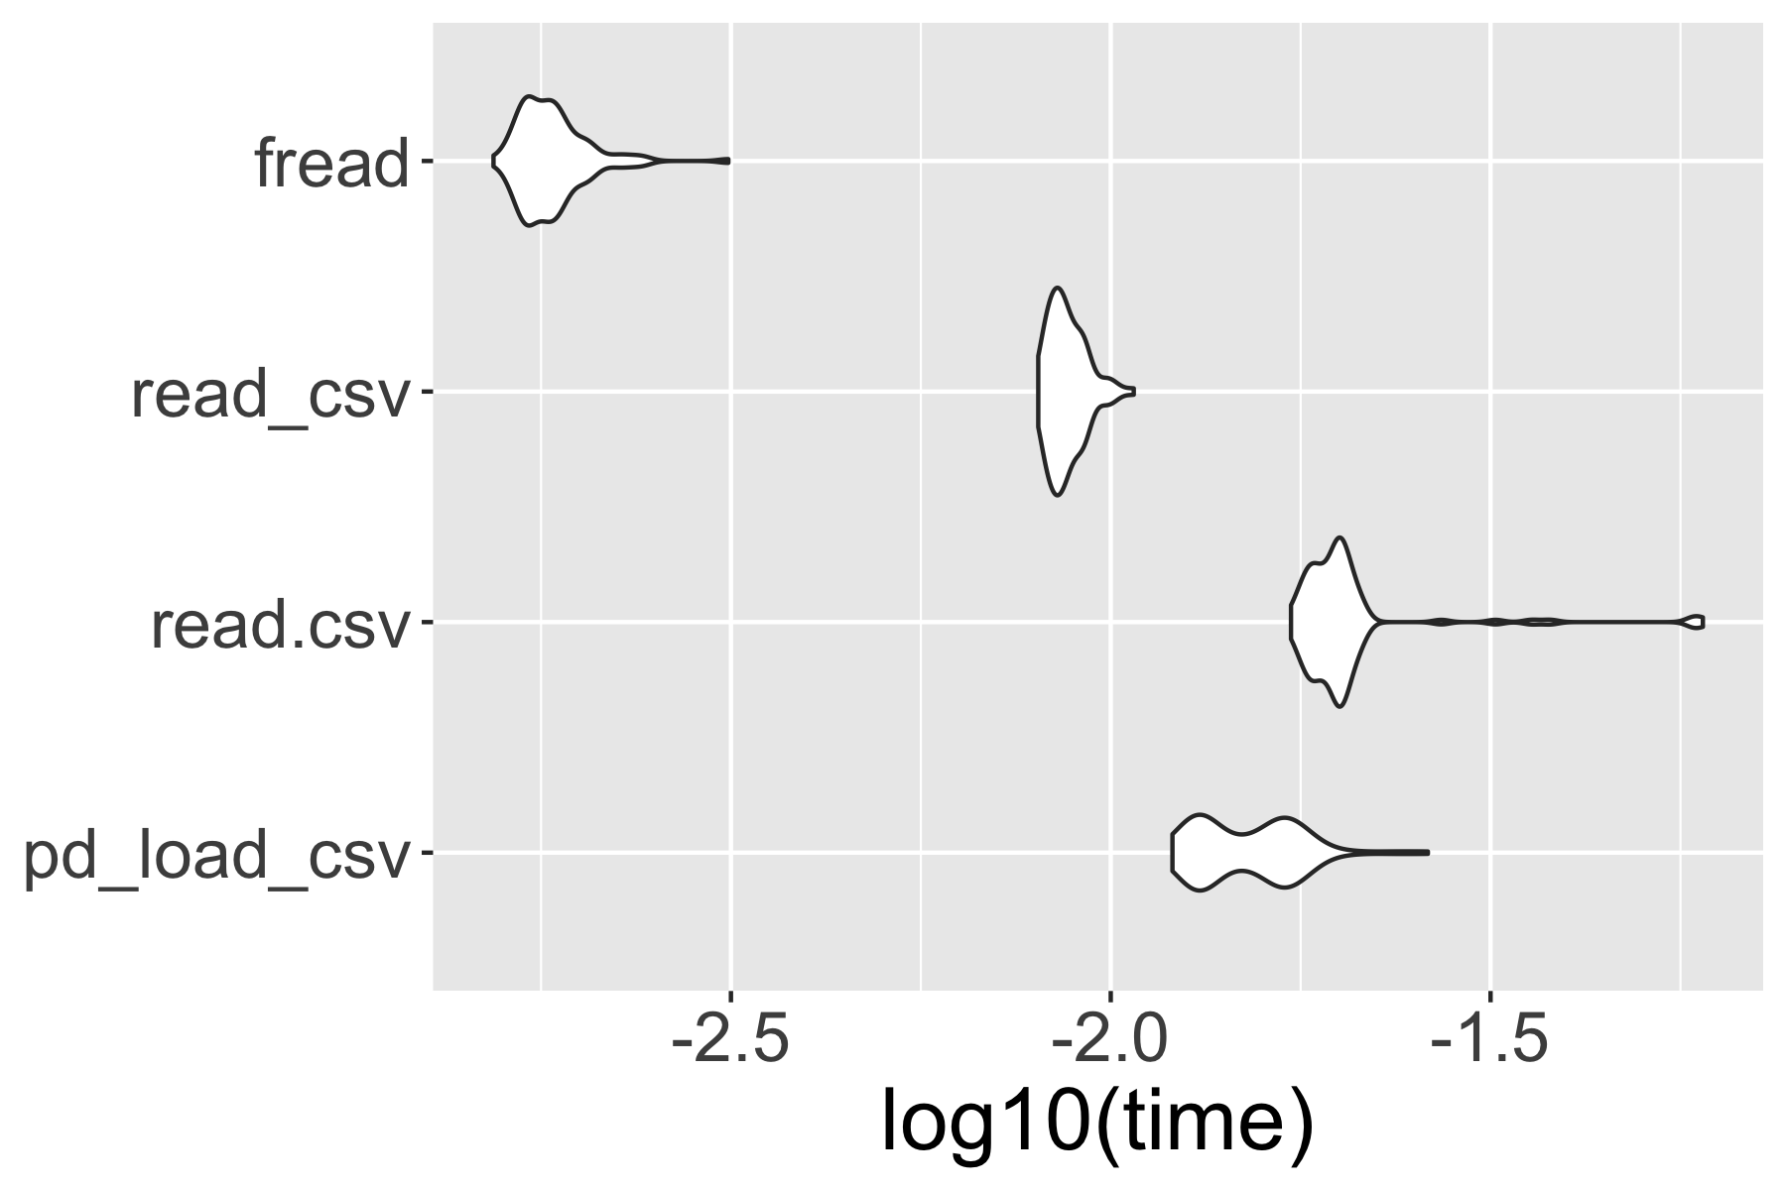
Benchmark test

Slide 57
Use Python in R
Import Python source
source_python("sample.py")
iris %>%
pd_head(5)
## y_call_impl(callable, dots$args, dots$keywords) ## でエラー:
## TypeError: cannot do slice indexing on <class
## 'pandas.core.indexes.range.RangeIndex'> with ## these indexers [5.0] of <class 'float'>

Slide 58
Variable type (basic)
Character
String
> typeof("1")
[1] "character"
>>> type("1")
<type 'str'>
Double
Float
> typeof(1)
[1] "double"
> typeof(1.0)
[1] "double"
>>> type(1.0)
<type 'float'>
Integer
Integer
> typeof(as.integer(1))
[1] "integer"
>>> type(1) <type 'int'>
> typeof(1L)
[1] "integer"

Slide 59
Use Python in R
Import Python source
source_python("sample.py")
iris %>%
pd_head(5)
# type ERROR
iris %>%
pd_head(5L)
# set as integer

Slide 60
reticulate package
Calling Python from R in a variety of ways including R Markdown, sourcing Python scripts, importing Python modules, and using Python interactively within an R session.
Translation between R and Python objects (for example, between R and Pandas data frames, or between R matrices and NumPy arrays).
URL: https://github.com/rstudio/reticulate

Slide 61
reticulate package
Calling Python from R in a variety of ways including R Markdown, sourcing Python scripts, importing Python modules, and using Python interactively within an R session.
Translation between R and Python objects (for example, between R and Pandas data frames, or between R matrices and NumPy arrays).
URL: https://github.com/rstudio/reticulate

Slide 62
Use Python in Rmd
Create .Rmd file
File > New File > R markdown
Import Python virturalenv in R chunk
```{r}
library(reticulate)
pyenv <- "<prj>/.venv/bin/python"
use_python(python = pyenv, required = TRUE)
```

Slide 63
Use Python in Rmd
Use Python in python chunk
```{python}
import pandas as pd
path = "<path>/sample.csv"
df = pd.read_csv(path)
df.head(3)
```

Slide 64
Use Python in Rmd
Use Python in python chunk
```{python}
import pandas as pd
path = "<path>/sample.csv"
df = pd.read_csv(path)
df.head(3)
```
preview

Slide 65
Use Python in Rmd
Shear pyobj between pychunks
```{python}
import pandas as pd
path = "<path>/sample.csv"
df = pd.read_csv(path)
```
```{python} df.head(3) ```

Slide 66
Use Python in Rmd
Import R object to python chunk
```{python}
import pandas as pd
df = r.iris
df.head(3)
```

Slide 67
Use Python in Rmd
Import R object to python chunk
```{python}
import pandas as pd
df = r.iris
```
Import python object to R chunk
```{r}
py <- import_main()
py$df
```

Slide 68
Benchmark test in python chunk
```{python}
import pandas as pd
from time import time
path = "<path>/sample.csv"
result = []
for i in range(100):
start = time()
df = pd.read_csv(path)
time_i = time() - start
result = result.append(time_i)
```

Slide 69
Benchmark visualization in R chunk
```{r}
py <- import_main()
py$result %>% data.frame(expr = "py_pd", time = .) %>%
rbind(data.frame(mbm) %>%
mutate(time = time/10^9)) %>%
ggplot(aes(expr, log10(time)))+
gem_violin()+
coord_flip()
```

Slide 70
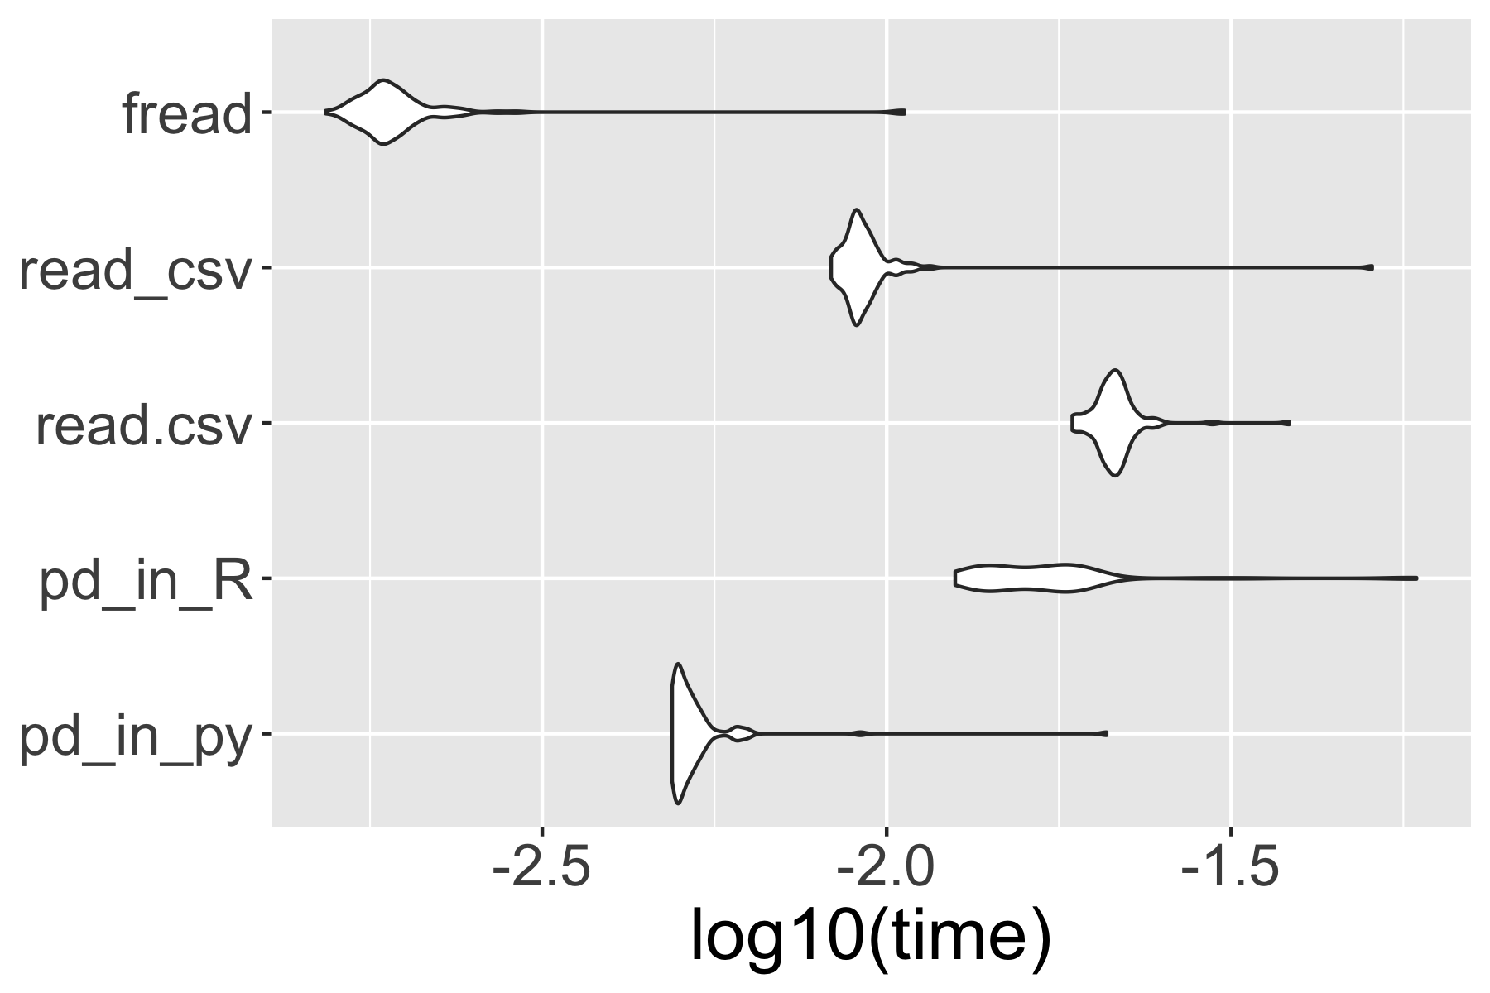
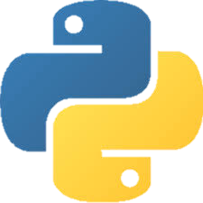
Benchmark visualization in R chunk

Slide 71
reticulate package
Calling Python from R in a variety of ways including R Markdown, sourcing Python scripts, importing Python modules, and using Python interactively within an R session.

Slide 72
reticulate package
Calling Python from R in a variety of ways including R Markdown, sourcing Python scripts, importing Python modules, and using Python interactively within an R session.

Slide 73
Run Python in Rstudio
1. Attach Python virtualenv in R
library(reticulate)
pyenv <- "<prj>/.venv/bin/python"
use_python(python = pyenv, required = TRUE)
2. Create .py file
File > New File > Python script
3. write in .py file
a = 1

Slide 74

https://www.amazon.co.jp/dp/B00Y0UI990/

Slide 75
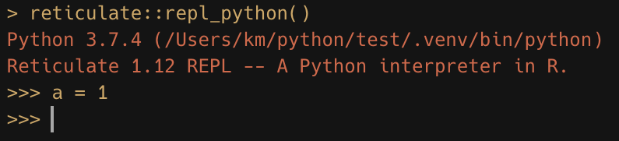

Slide 76
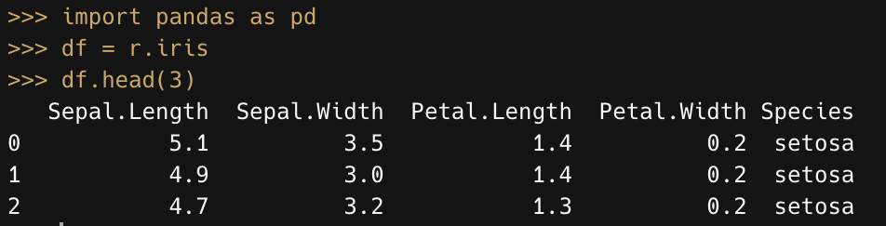

Slide 77
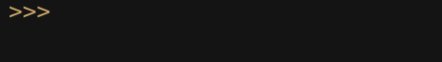
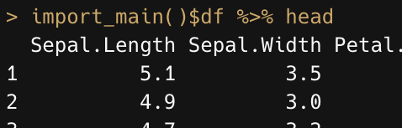
(escape key)

Slide 78
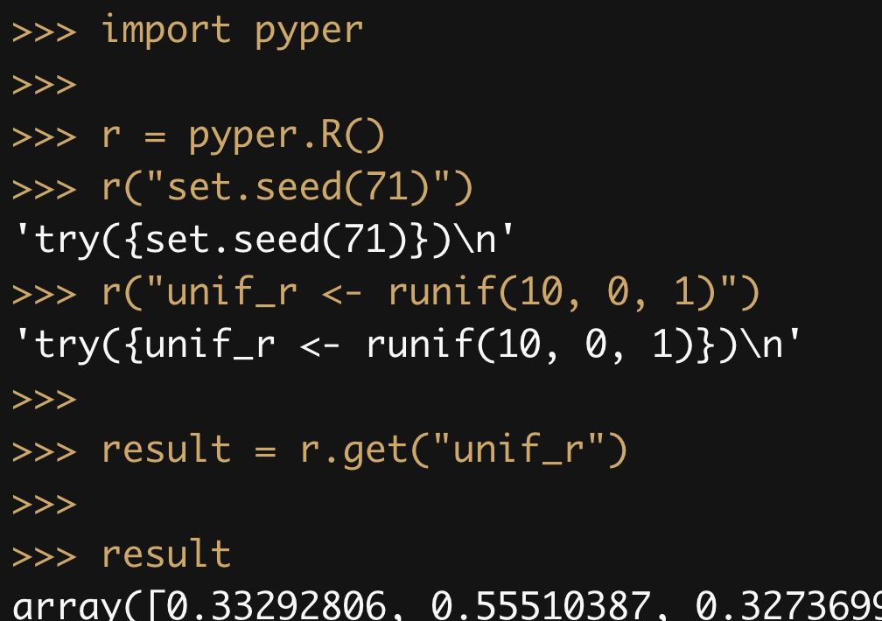

Slide 79
reticulate package
Calling Python from R in a variety of ways including R Markdown, sourcing Python scripts, importing Python modules, and using Python interactively within an R session.

Slide 80
summary

Slide 81
RStudio
Projects

Slide 82
"Sandboxed" Python
Isolated & Independent virtual environment for security & reproducibility
[python]
version = "3.7"
[packages]
cycler==0.10.0
kiwisolver==1.1.0
matplotlib==3.1.1
numpy==1.16.4
opencv-python==4.1.0.25
pandas==0.25.0
pyparsing==2.4.0
PypeR==1.1.2 ...
[python]
version = "2.7"
[packages]
numpy==1.16.4
...

Slide 83
Pipenv
→ "Sandboxed" Python manager
Create virtualenv
$ cd <project root>
$ pipenv --python 3.7
<project root>
.venv
← interpreter, env info
Pipfile
← package info

Slide 84
Use Python in R
Install reticulate from CRAN
install.packages(reticulate)
Attach Python virtualenv
library(reticulate)
pyenv <- "<prj>/.venv/bin/python"
use_python(python = pyenv, required = TRUE)

Slide 85
Use Python in R
Import Python source
pd <- import("pandas")
source_python("sample.py")
Shear pyobj between pychunks in Rmd
```{python}
import pandas as pd
path = "<path>/sample.csv"
df = pd.read_csv(path)
```

Slide 86
Run Python in Rstudio
1. Attach Python virtualenv in R
library(reticulate)
pyenv <- "<prj>/.venv/bin/python"
use_python(python = pyenv, required = TRUE)
2. Create .py file
File > New File > Python script
3. write in .py file
a = 1

Slide 87
reticulate package
Calling Python from R in a variety of ways including R Markdown, sourcing Python scripts, importing Python modules, and using Python interactively within an R session.

Slide 88
2
Do NOT start from here
Input
3
1
Whatever
Output
…

